Slide 1
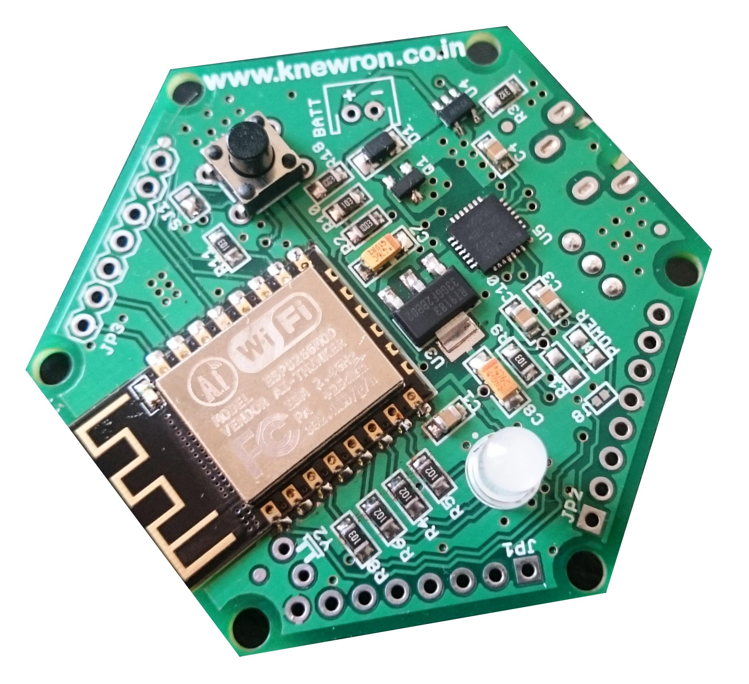
ESP module pins
Battery charging section
1 GPIO 15
2 GPIO 2
3 GPIO 5
4 3.3V
5 GND
6 ESP RX
7 ESP TX
USB to serial converter
Power supply
8 NC
7 NC
6 NC
5 GND
4 MOSI
3 MISO
2 SCK
1 RESET
1 ADC2
2 ADC3
3 ADC4 / SDA
4 ADC5 / SCL
5 NC
6 NC
7 3.3V
8 GND
ATmegaxx8 pins
ATmegaxx8 pins

Slide 2
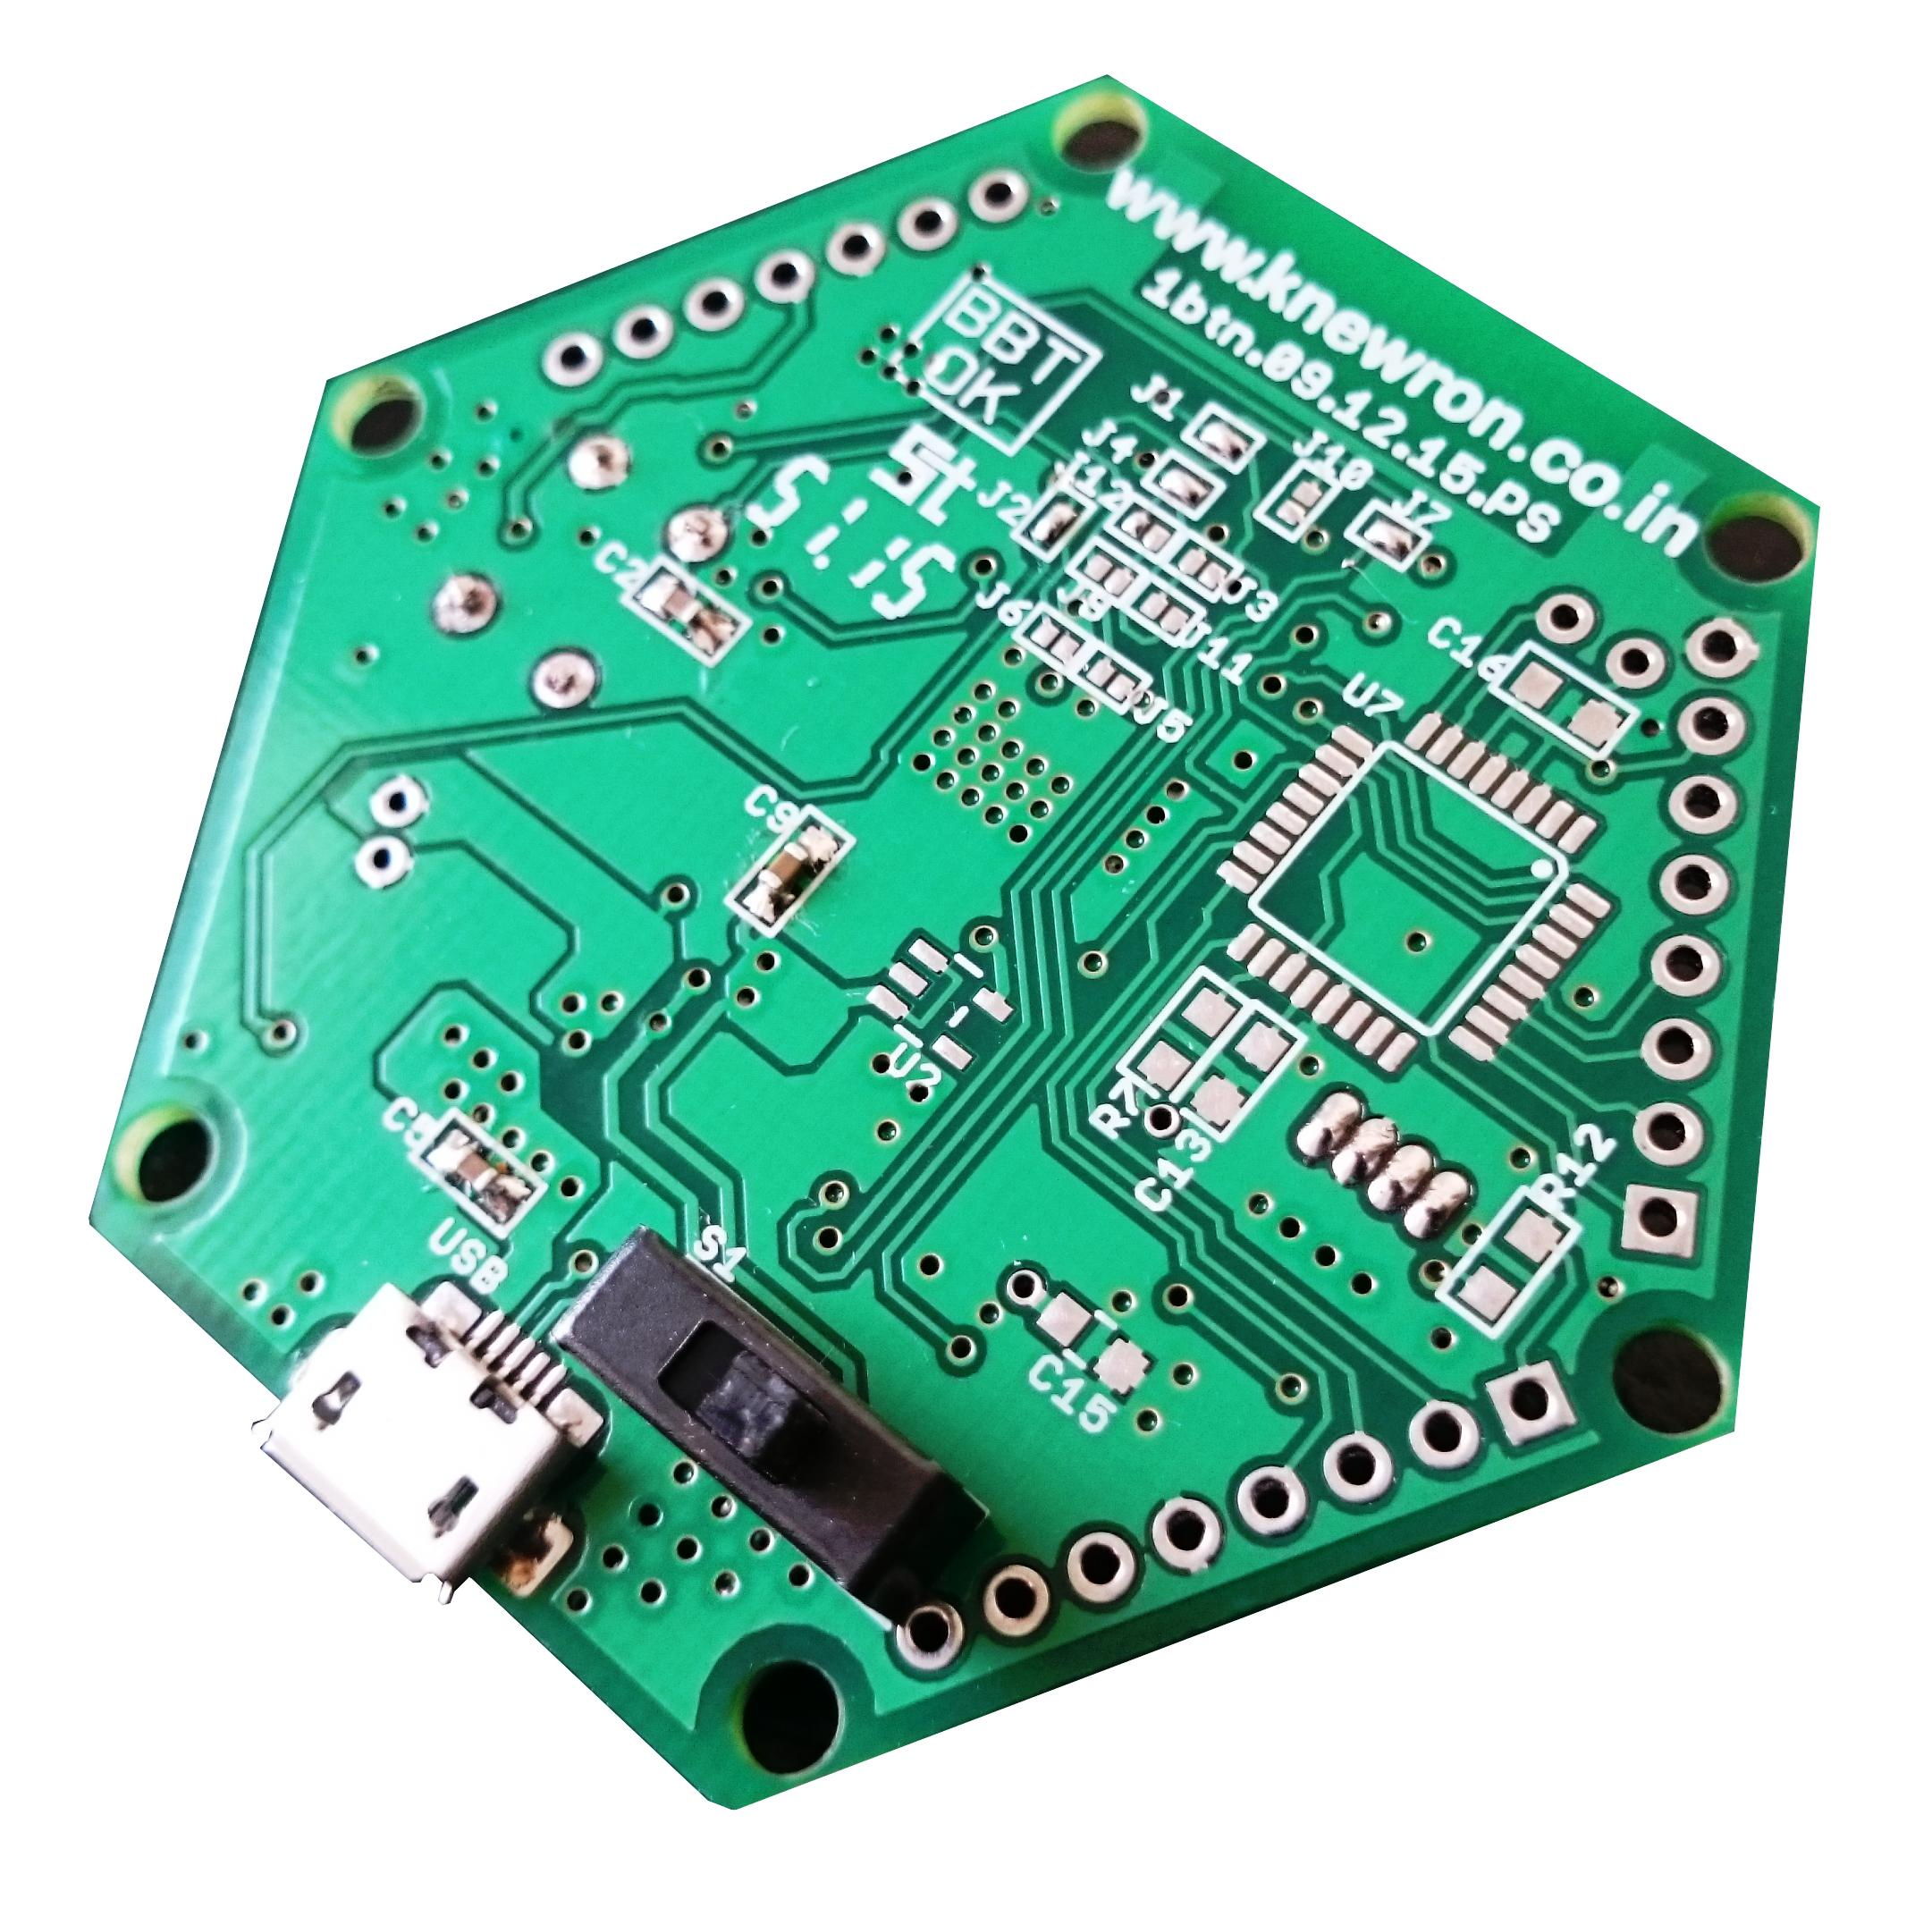
Jumper settings to enable ATmegaxx8 based operation
ATmegaxx8
Power On / Off
USB connector

Slide 3
JP 3 - ESP module pins
Section 1
Pin # 1
|
|
|
|
|
Pin # 7
Section 2
Section 3
Pin # 8
|
|
|
|
|
|
Pin # 1
Pin # 1
|
|
|
|
|
|
Pin # 8
JP2 - ATmegaxx8 pins
JP1 - ATmegaxx8 pins

Slide 4
Section 4
Section 5
Power On / Off
USB connector

